Slide 1
ECE 5397/6397:
Introduction to Robotics
Lecture 9:
Inverse kinematics examples: Articulated arm, SCARA arm, and spherical wrist.
Reference: Chapter 3.3, RD&C
Instructor: Aaron Becker
Notes:
Email class:
hand in prep for lecture 6, and 7.
Send the link for the lectures.
And the worksheets
And the answers
Send link to video: https://www.youtube.com/watch?v=SOESSCXGhFo

Slide 2
Welcome!
Bring robot arms to class next Tuesday for a photo
We have batteries and battery cases for you in N386
10 robot arm kits in the lab (no servo). Should be enough for everybody in class to have a robot arm.
Spare parts are in the lab, come by if you need them. Please do not take parts from completed kits. If the spare part you need isn't there put a note in the box.
Out of 3x12mm screws, so substitute 3x10mm

Slide 3
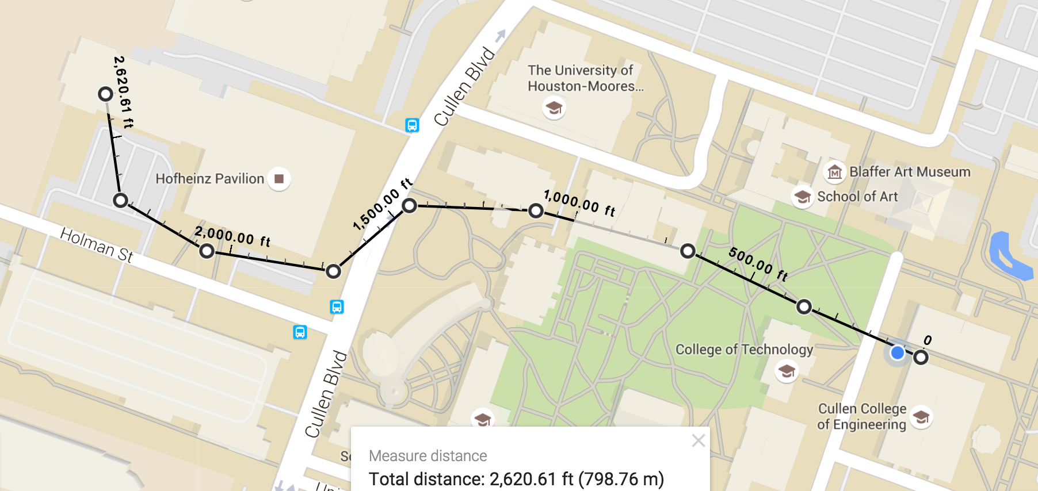
Opportunity!
UH charter school is 2600ft away. Who could bring their arm next Tuesday at 10 to the charter school?
South Early High school robotics club would enjoy a visit on a Friday (11 high school students)
Notes:
Ideas:
We could bring Lego blocks and play, in partners, ‘control the robot’ where one partner’s eyes are closed and the other tells them how to pose the arms to grab a block on the table.
Have ‘robot’ eyes open and give controller a picture of blocks, and have them direct the robot to build it.
Students show children their robot.

Slide 4
Define Inverse Kinematics

Slide 5
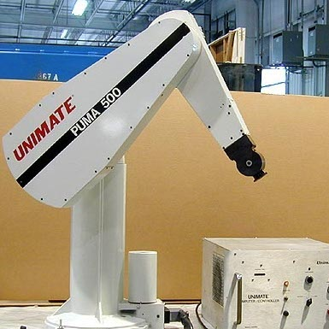
Inverse Kinematics Caveats
May or may not have a solution
Even if solution exists, may or may not be unique
Because forward kinematics is generally nonlinear, solutions can be hard to obtain even if they exist
Example: pretend you are a PUMA arm – how many solutions?

Slide 6
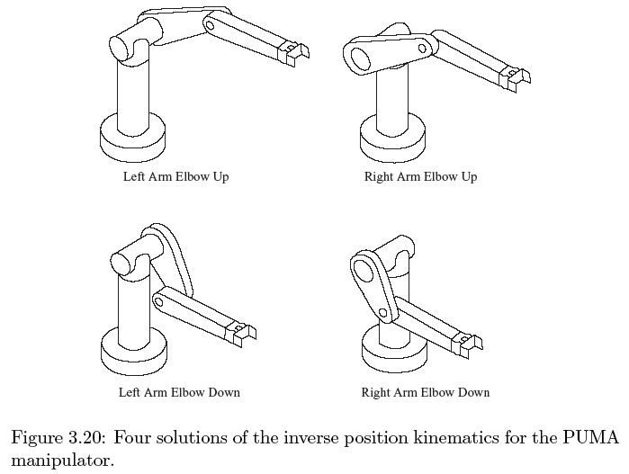
Multiple solutions

Slide 7
Inverse Kinematics Goal

Slide 8
Why closed form?
Much faster (Omron uses a 1/8 ms control loop in 2016)
Iterative search is slow
Kinematics has multiple solutions, we need system to choose (imagine what happens if switching allowed)

Slide 9
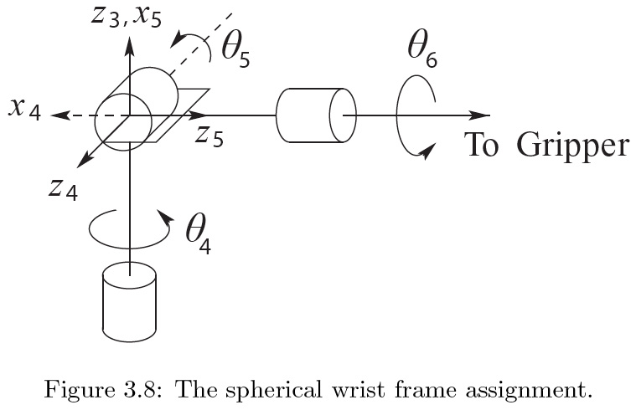
Inverse Kinematics Trick: kinematic decoupling
Possible if 6 joints and last 3 joint axis intersect at a point
Find position of writs axes (w.c.) o_{c}
Find orientation of the wrist
Tool frame o
(w.c.) o_{c}
Notes:
----- Meeting Notes (2/16/16 12:49) -----
label o

Slide 10
Solve with kinematic decoupling (position)
Tool frame o
(w.c.) o_{c}

Slide 11
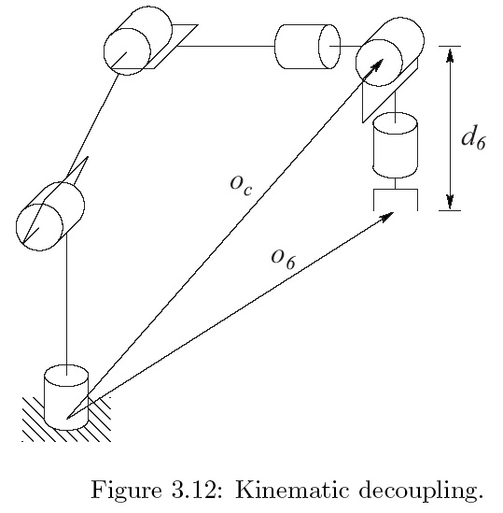
Answer: kinematic decoupling (position)

Slide 12
Solve kinematic decoupling (orientation)
Notes:
Underline what is given and what is determined by first 3 joint variables

Slide 13
Answer kinematic decoupling (orientation)

Slide 14
Geometric Approach for inverse position
Notes:
Why – partly due to difficult of inverse kinematics
Most manipulators are kinematically simple
Few techniques that can handle general inv. Kinematics problem for arbitrary configurations
Complexity increases with # of DH parameters. Most manipulatos zero out terms and angles are pi/2 or 0.

Slide 15
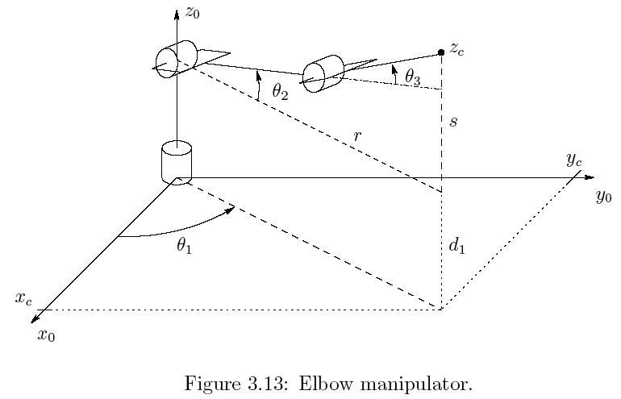
Articulated Manipulator
d₁
=
r=

Slide 16
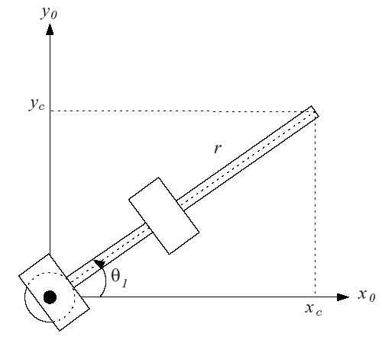
Project onto (x₀,y₀)
Notes:
What is the other valid theta_1? Act it out

Slide 17
Ans: Project onto (x₀,y₀)
Notes:
What is the other valid theta_1? Act it out

Slide 18
Second solution

Slide 19
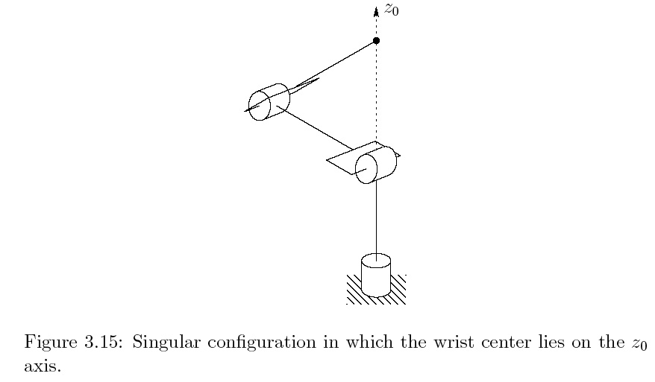
Singular configurations

Slide 20
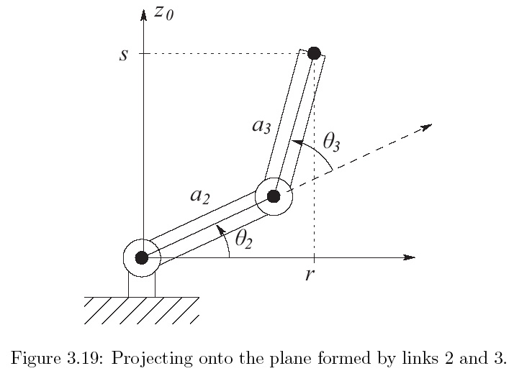
q₂,q₃
Notes:
On board
----- Meeting Notes (2/16/16 12:49) -----
r not a

Slide 21
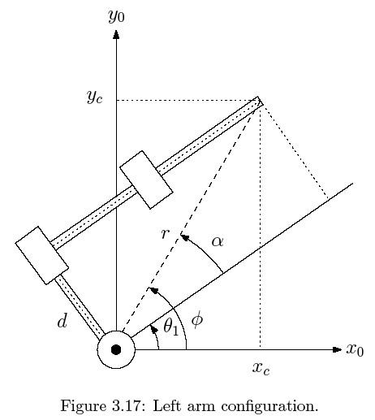
Making it harder: let d>0, left arm
Notes:
----- Meeting Notes (2/16/16 12:49) -----
why not pos and neg distances for r?

Slide 22
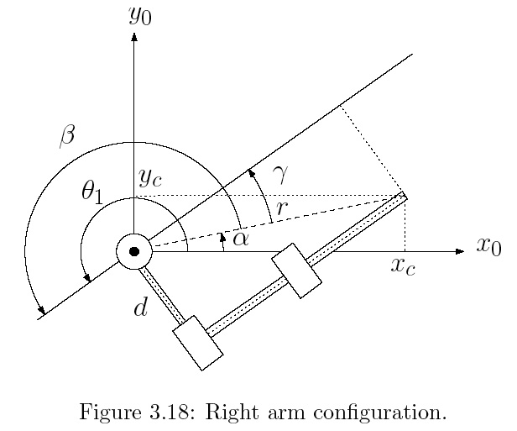
d>0, right arm

Slide 24
For the Next Class
Study Ch 4.1-4.3 for Lecture 10

Slide 25
In class worksheet

